Slide 1
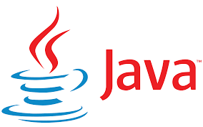
Object Oriented Programming with Java 23CP201T

Slide 2
Pandit Deendayal Energy University |  |  |  |  |  |  | School of Technology
23CP201T |  |  |  |  | Introduction to Programming with Java -23CP201T
Teaching Scheme |  |  |  |  | Examination Scheme
L | T | P | C | Hrs/Week | Theory |  |  |  | Practical |  | Total Marks
 |  |  |  |  | MS | ES |  | IA | LW | LE/Viva
3 | 0 | 2 | 4 | 5 | 25 | 50 |  | 25 | - | - | 100

Slide 3
Origins of Java Programming Language
In 1990s, Sun microsystems was conceived a project naming Green project, to develop a software for consumer electronics devices.
In 1991, Project manager James Gosling(Father of Java programming language), and his team members met to discuss about this project.
C and C++ were platform dependent language, and team was looking for language which is independent from platform and could be able to run on various electronics devices.

Slide 4
Origins of Java as a Programming Language
James gosling with his team started developing a new language which was completely platform independent.
This was initially called ‘Oak’ and but name was already registered so later it changed to ‘Java’.
The Java programming language's birthdate is May 23, 1995.
Java 1.0, the first official release of the language, was made available to the public on January 23, 1996.

Slide 5
Java as a Programming Language
Java is widely used in various domains, including web development, mobile app development (especially Android apps), enterprise software, scientific applications, cloud-based services, and more. It continues to be a popular programming language, powering a vast array of applications and systems worldwide.
Java is a set of several computer software product and specifications from Sun Microsystems (acquired by Oracle Corporation in 2010).
Together provide a system for developing variety of software and deploying it in a cross-platform computing environment.

Slide 6
Java as a Programming Language
Java eliminates certain low-level constructs such as pointers and has a very simple memory model where every object is allocated on the heap and all variables of object types are references.
Java syntax borrows heavily from C and C++, but object-oriented features are modeled after Smalltalk and Objective-C.

Slide 7
Java as a Programming Language
Java is used in a wide variety of computing platforms from embedded devices and mobile phones on the low end, to enterprise servers and supercomputers on the high end.
Java SE(Standard Edition) : Java SE (Java Platform, Standard Edition) is the core platform and foundation of the Java programming language. It provides the basic libraries, tools, and runtime environment necessary for developing and running Java applications on desktops, servers, and other non-enterprise environments.
Java ME (Micro Edition): Specifies several different sets of libraries (known as profiles) for devices with limited storage, display, and power capacities. Often used to develop applications for mobile devices, and wide range of IOT(Internet Of Things) devices,TV set-top boxes, and printers.

Slide 8
Java as a Programming Language
Java EE(Enterprise Edition): Java EE (Java Platform, Enterprise Edition) is a set of specifications and APIs (Application Programming Interfaces) provided by Oracle Corporation (previously Sun Microsystems).
It extend the Java Platform, Standard Edition (Java SE) to support enterprise-level applications. It is designed to facilitate the development and deployment of large-scale, distributed, and robust enterprise applications.

Slide 9
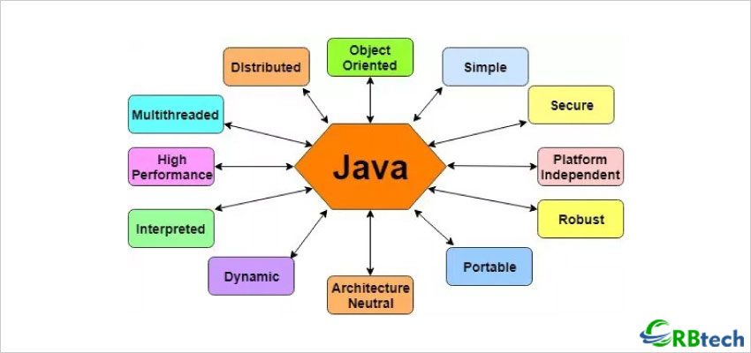

Java Features

Slide 10
Features of Java-Simple
Java is easy to learn and its syntax is quite simple, clean and easy to understand.
The confusing and ambiguous concepts of C++ are either left out in Java or they have been re-implemented in a cleaner way.
Eg : Pointers and Operator Overloading are not there in java but were an important part of C++.

Slide 11
Object-Oriented
In Java, everything is an object which has some data and behaviour. Java can be easily extended as it is based on Object Model. Following are some basic concept of OOP's.
Class – Objects – Methods
Encapsulation ( Data Hiding)
Abstraction
Inheritance
Polymorphism

Slide 12
Robust
Java is often praised for its robustness, which refers to its ability to handle errors, exceptional conditions gracefully while ensuring the stability and reliability of the software.
Well tested and maintained standard library, statically type checking, structured exception handling, Automatic memory management, etc.. are some features which provides robustness.

Slide 13
Platform-independent
Java's platform independence, often referred to as “Write Once, Run Anywhere" (WORA), is one of its most significant advantages.
This feature is achieved through bytecode compilation and platform specific Java Virtual Machine(JVM) execution.
On compilation Java program is compiled into bytecode. This bytecode is platform independent and can be run on any machine, having compatible Java Runtime Environment can run Java Programs.

Slide 14
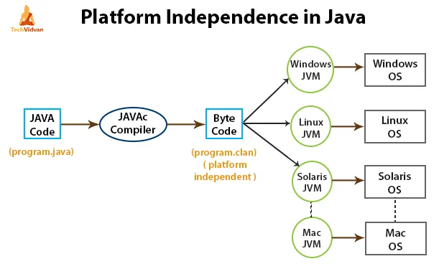
Platform -Independent Feature

Slide 15
Bytecode
Bytecode is the intermediate representation of a Java program, allowing a JVM to translate a program into machine-level instructions.
When a Java program is compiled, bytecode is generated in the form of a . class file
Java bytecode serves as a bridge between the platform-independent Java source code and the platform-specific machine code executed by the CPU.
It allows Java developers to write code once and run it anywhere, as long as there is a JVM compatible with the target platform.

Slide 16
Simple Memory Management
Java memory management mechanisms automatically free the memories whenever the need arises, so you don’t have to do it yourself.
This automated system makes your job easier, and allows you to focus on the finer details of your application development.

Slide 17
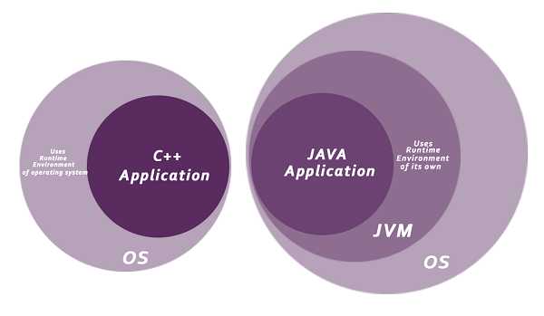
Security
Java is secure because Java programs run inside a virtual machine which is known as a sandbox(It’s own runtime environment).
Java does not support pointer. Byte-code verifier checks the code fragments for illegal code access that can violate access right to object.

Slide 18
Multithreading
Java multithreading feature makes it possible to write program that can do many tasks simultaneously.
Benefit of multithreading is that it utilizes same memory and other resources to execute multiple threads at the same time, like While typing, grammatical errors are checked along.

Slide 19
Portable and Architectural Nuetral
Java Byte code can be carried to any platform. No platform specific(dependent) features features.
Everything related to storage is predefined, example: fixed size of primitive data types

Slide 20
Distributed
Java is also a distributed language.
Programs can be designed to run on computer networks.
Java has a special class library for communicating using TCP/IP protocols.
Creating network connections is very much easy in Java as compared to C/C++

Slide 21
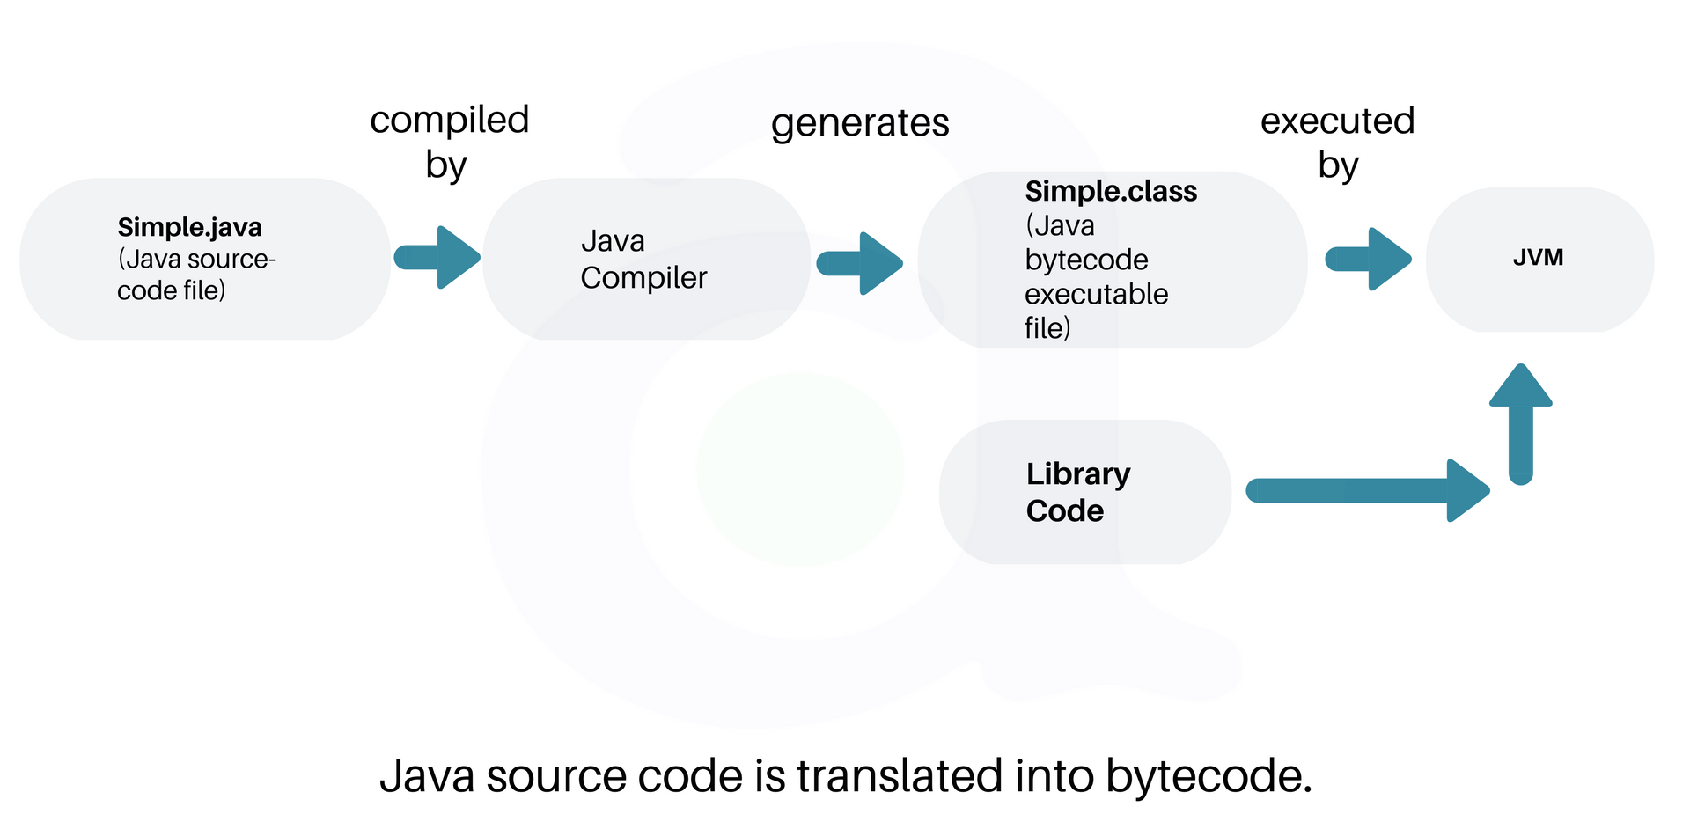
Java CodeFlow

Slide 22
Java – Programming Language
Java: It is a software platform for building (using JDK) cross-platform applications and for safely executing these applications (using JRE) on their underlying system. The Java platform includes implementations for
JVM(Java Virtual Machine)
JRE(Java Runtime Environment)
JDK (Java Development Kit)

Slide 23
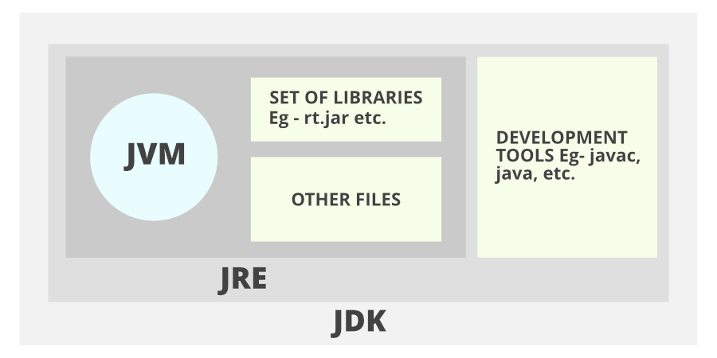
Java Development Kit(JDK)

Slide 24
JRE
The Java Runtime Environment (JRE) provides the libraries, the Java Virtual Machine, and other components to run applications written in the Java programming language.
JRE does not contain tools and utilities such as compilers or debuggers for developing and compiling applications.

Slide 25
JDK
The JDK also called Java Development Kit
It is a superset of the JRE, and contains everything that is in the JRE.
Apart from JRE, other tools such as the compilers and debuggers necessary for developing and compiling applications.

Slide 26
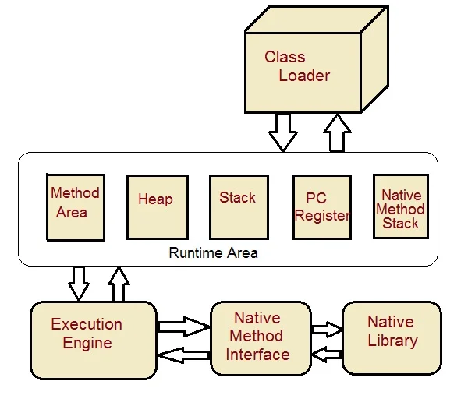
JVM

Slide 27
Java Virtual Machine(JVM)
Java Virtual Machine (JVM) - It is the execution engine of java programs. It is responsible for loading and executing a java program for providing it with runtime support.
JVM is fully specified by Sun Microsystems and basically consists of following components.
Bootstrap Loader
Hotspot Engine
Garbage Collector

Slide 28
Bootstrap Loader : It is the primary class loader of JVM which is responsible for creating a class/interface with a specified name from its byte codes
Hotspot engine : It translates architecture neutral byte codes to machine specific native codes for execution.It also detects repetitive code blocks (hotspots) and caches their native codes for final execution.
Thread Scheduler

Slide 29
Java Virtual Machine
Garbage Collector : It assigns memory blocks to java objects on the heap preallocated by JVM at startup.
It also automatically reclaims the memory blocks assigned to the objects when they are no longer referenced.
Thread Scheduler :
It handles creation, execution and syncronisation of threads under JVM .It also performs preemptive contact switching between the executing threads.All OS does not support threading model sometimes OS supports but scheduling model differs. So java implements its own Thread Scheduler.

Slide 30
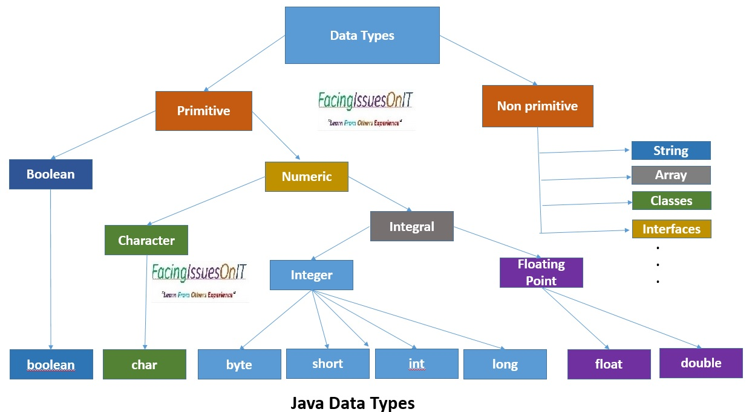

Slide 31
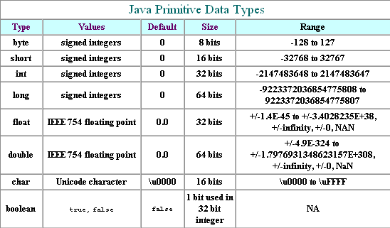

Slide 32
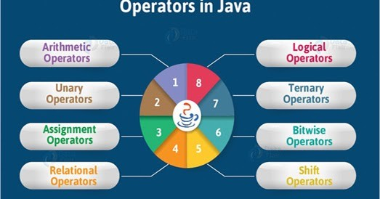
Java Operators

Slide 33
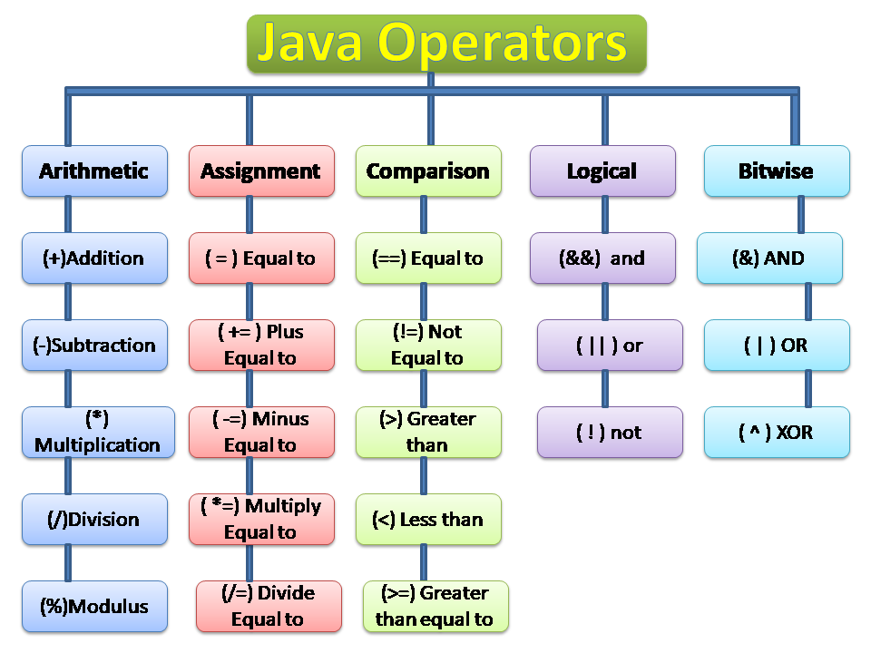

Slide 34
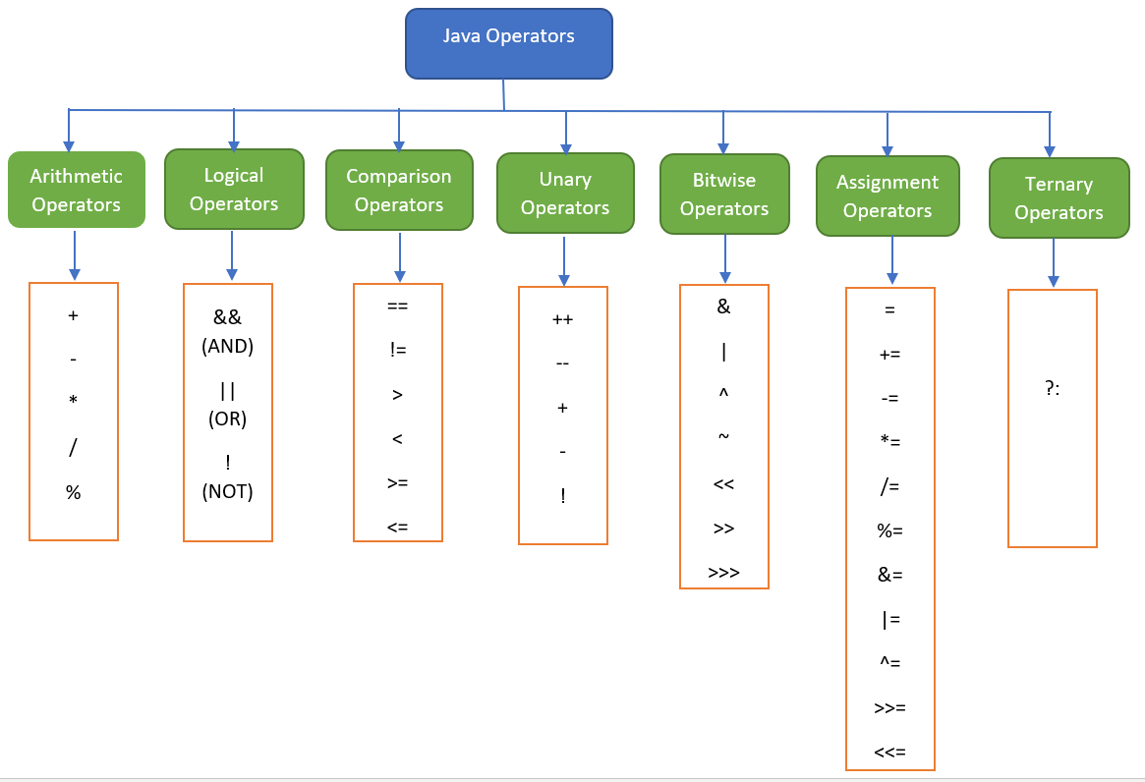

Slide 35
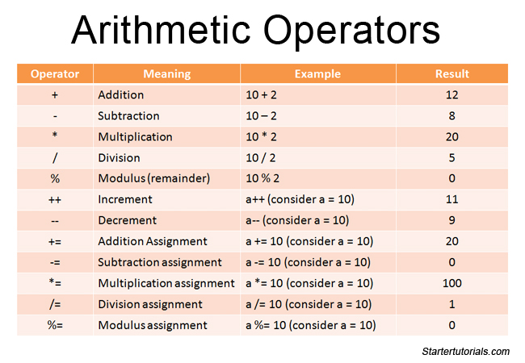

Slide 36
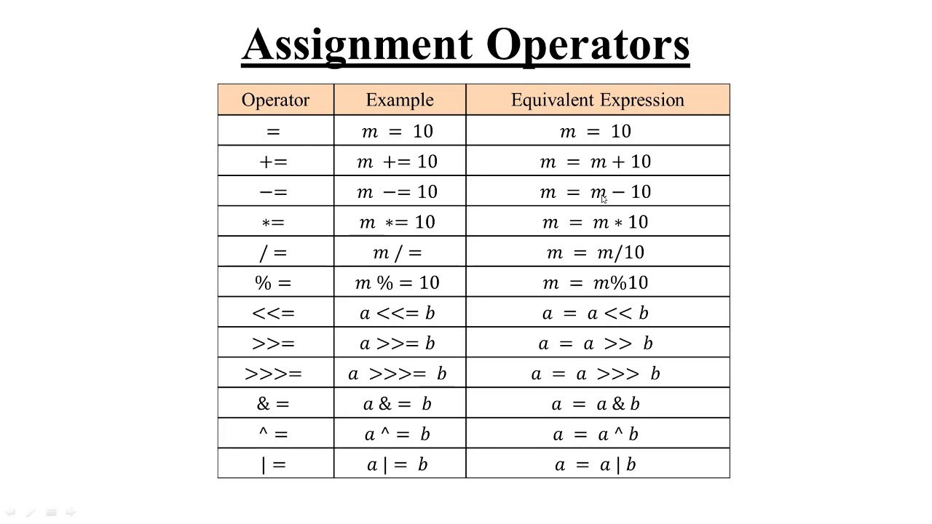

Slide 37
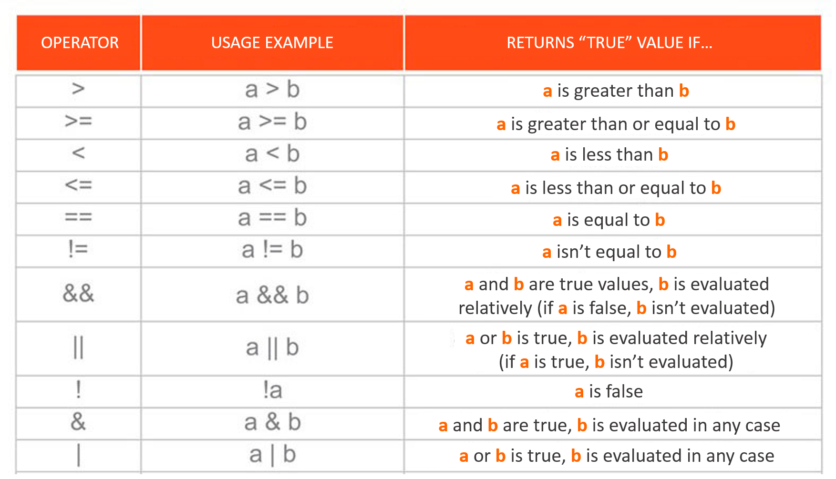

Slide 38
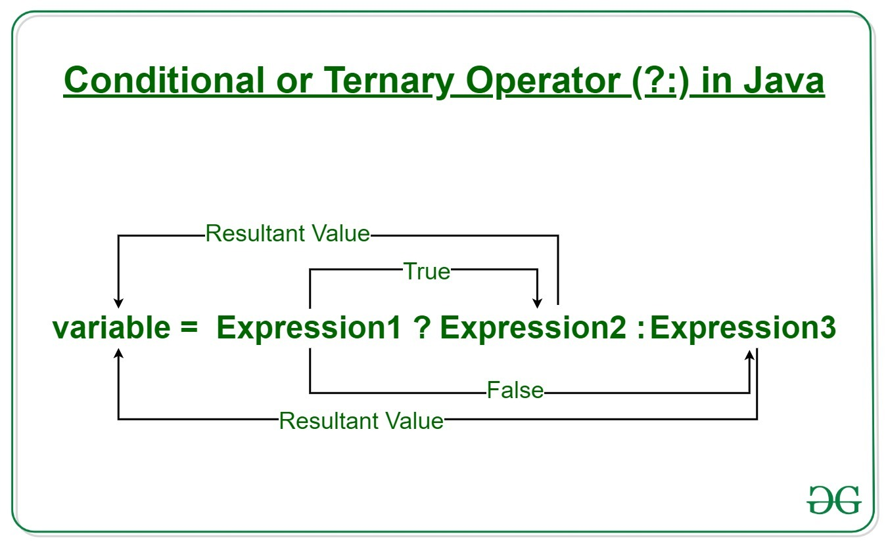

Slide 39
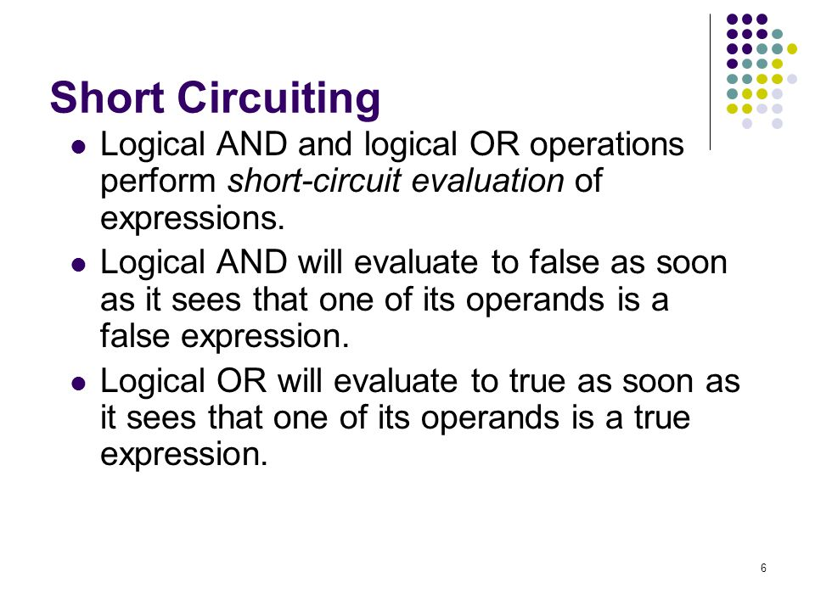

Slide 40
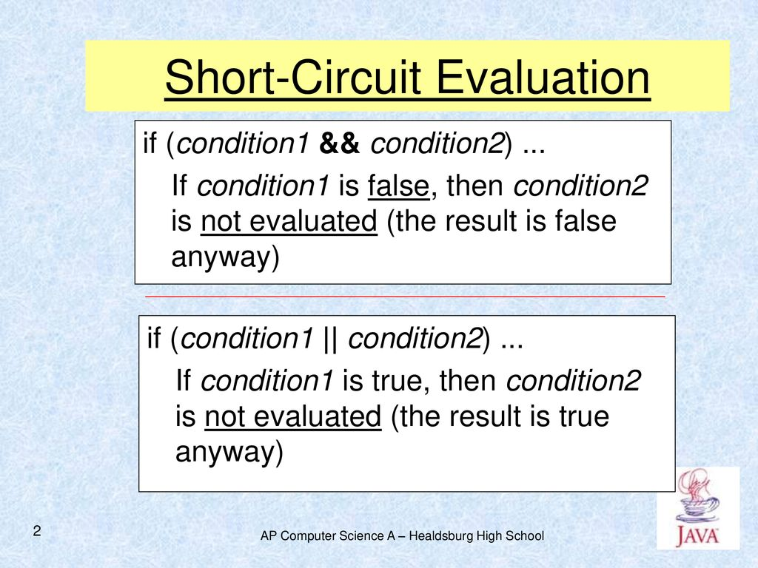

Slide 41
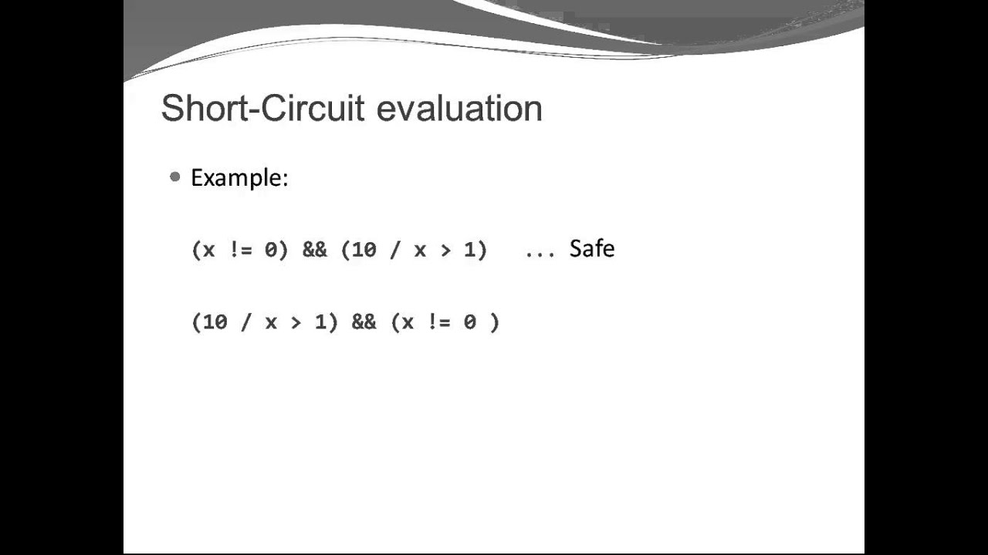

Slide 42
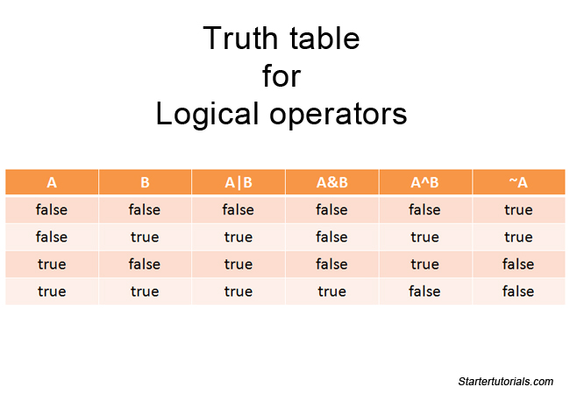

Slide 43
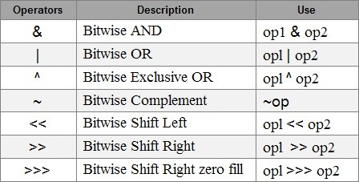
Bitwise Operators

Slide 44
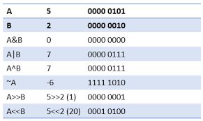
Bitwise Operators

Slide 45
Identifiers(Variables)
Identifiers are used for class names, method names, and variable names.
An identifier may be any descriptive sequence of uppercase and lowercase letters, numbers, or the underscore and dollar-sign characters.
They must not begin with a number, Again, Java is case-sensitive, so VALUE is a different identifier than Value. Some examples of valid identifiers are:
AvgTemp count a4 $test this_is_ok
Invalid variable names include: 2count high-temp Not/ok

Slide 46
Literals
Literals : A constant value in Java is created by using a literal representation of it.
For example, here are some literals:
100 98.6 ‘X’ “This is a test”

Slide 47
Comments
Comments : There are three types of comments defined by Java.
You have already seen two: single-line and multiline. The third type is called a documentation comment.
This type of comment is used to produce an HTML file that documents your program.
The documentation comment begins with a /** and ends with a */
With javadoc utility we can create documentation comment.

Slide 48
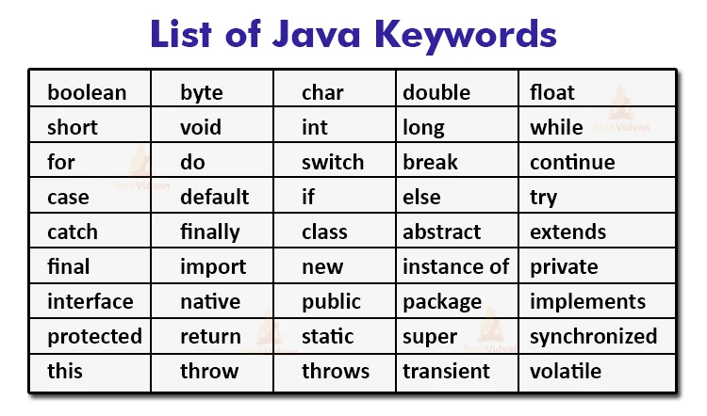

Slide 49
Keywords
In addition to the keywords, Java reserves the following: true, false, and null.
These are values defined by Java. You may not use these words for the names of variables, classes, and so on.

Slide 50
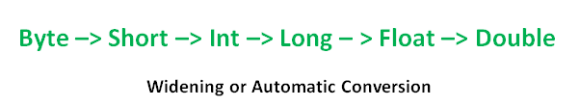
Types of Conversion
Widening – Widening conversion takes place when two data types are automatically converted. This happens when:
The two data types are compatible.
When we assign a value of a smaller data type to a bigger data type.
Conversion of sub-types to one of it’s super-type is widening conversion.

Slide 51
// Java Program to Illustrate Automatic Type Conversion
Widening Conversion Example
public static void main(String[] args)
{
int i = 100;
// Automatic type conversion Integer to long type
long l = i;
// Automatic type conversion long to float type
float f = l;
// Print and display commands
System.out.println("Int value " + i);
System.out.println("Long value " + l);
System.out.println("Float value " + f);
}
}

Slide 52

Narrowing or Explicit Conversion
Narrowing - If we want to assign a value of a larger data type to a smaller data type we perform explicit type casting or narrowing.
This is useful for incompatible data types where automatic conversion cannot be done.Here, the target type specifies the desired type to convert the specified value to.
Conversion of super-types to one of it’s sub-type.

Slide 53
Narrowing or Explicit Conversion
public static void main(String[] args)
{
double d = 100.04;
//Explicit type casting by forcefully getting data from double datatype to long type
long l = (long)d;
// Explicit type casting
int i = (int)l;
System.out.println("Double value " + d); // 100.04
// While printing we will see that fractional part lost
System.out.println("Long value " + l); // 100
System.out.println("Int value " + i); // 100
}
}

Slide 54
If any of two operands for a + operator is a String. The other operand would be automatically converted to a String type.
Try following expression :
System.out.println(“10 > 9 is : ” + (10 > 9));
System.out.println(“10 > 9 is : ” + 10 > 9); // Error!

